Slide 1
Activities Day July 21st and 22nd 2025

Slide 3
EASI

Slide 5
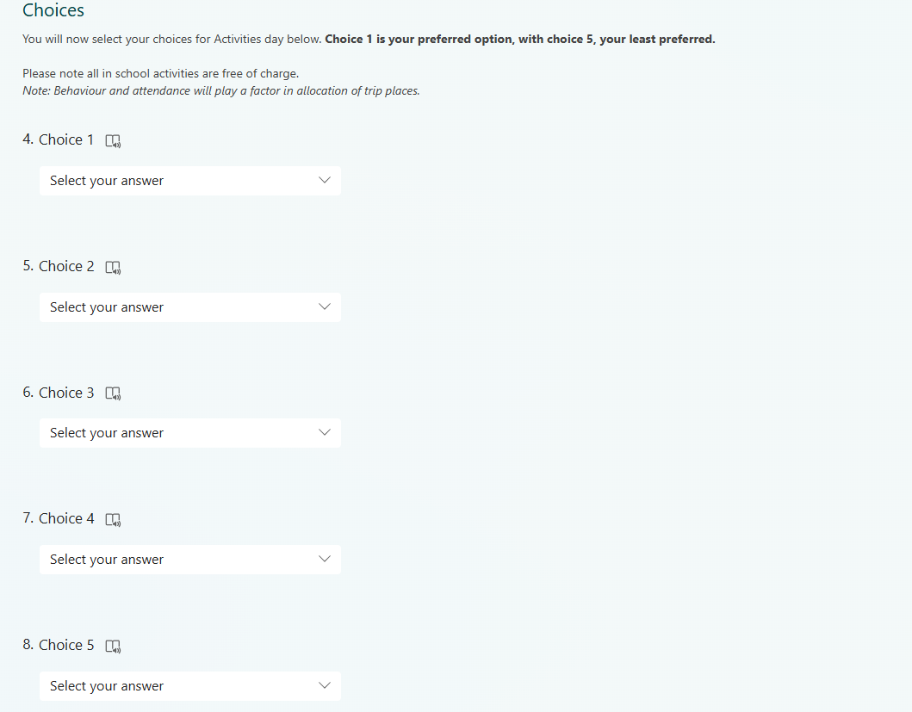

Slide 6
What happens next?
Friday 9th May - Information booklets handed to students in assembly/tutor time and activity week is launched
Friday 9th May until Wednesday 14th May - Students complete online Teams Form (on EASI), selecting their choices with their parents/carers
Friday 23rd May - Student choices confirmed to pupils and parents/carers and payment window opens
Monday 16th June - Deadline for all Parentpay payments and deadline for consent forms to be handed in.
Free school meal students only - Complete packed lunch request form if a packed lunch is required for any off-site trips. The form will be provided by Head of Year and should be returned to the Head of Year by Monday 14th July
Monday 21st and Tuesday 22nd - Activities Day.

