Slide 1

Activities Day
July 21st and 22nd
2025

Slide 2

I.
Activities Day Monday 21st and Tuesday 22nd July 2025
Dear Parent / Carer,
As a school, we are constantly seeking ways to improve and enhance your child’s educational experience. This year we would like to offer the opportunity for your child to participate in a range of new and exciting activities, to finish off the academic year.
The school will be suspending normal lessons and instead have organised a full day of activities for year 7-10 students on Monday 21st July and Tuesday 22nd July, which will provide your son/ daughter with a range of different and engaging alternatives to the normal curriculum.
The information in this brochure, will allow your child to nominate their preferred activity for both days. We have tried to ensure that there is something for everyone, either in school, or on a trip!
Places on external trips are allocated based on a number of factors. I would like to stress the importance of excellent behaviour and conduct whilst on a school trip and point out that only pupils who demonstrate this via their record of behaviour, conduct, effort and attendance will be considered suitable for certain trips. This is because at all times, pupils should be aware that they represent Biddick Academy and because of the health and safety issues involved in any venture outside of the classroom. Students will be provided with a link to a Teams Form to make their selection, via their school E-mail account (Outlook).
Once places are confirmed on trips, the preferred payment method is via ParentPay. Parents and carers will only pay for their child’s confirmed, allocated trips. If parents have any questions regarding payment or the trips, please contact the school office.
Students do not need to wear their uniform to participate in their chosen activities. We do however ask that all students dress appropriately, especially if they are likely to get wet or muddy. For every off-site activity, a parent/carer must complete a parental consent form, which will be sent to you separately, once the place is confirmed.
For all off-site activities, students will require a packed lunch or money to purchase a meal. If your child is currently receiving Free School Meals and would like a packed lunch provided by the school, we will arrange for this to be supplied on the day. Students will be provided with an order form in school during Form Time, by their Head of Year, in the penultimate week.
Please discuss choices with your child and nominate these activities by 9am Wednesday 14th May. Student choices will be confirmed on Friday 23rd May, once your child has been allocated a place, the balance will appear on their Parentpay account, which needs to be paid by Monday 16th June at 9am to secure their place.
Once all students have been allocated their activity, all of the specific information for their chosen activities will be sent out from the member of staff in charge.
We hope you will agree that the activities day has the potential to offer a stimulating and worthwhile contribution to your child’s life at school and we anticipate lots of happy memories will be made. We would like to thank you for your ongoing support of the school and we look forward to spending time with your child in a different environment and watching them enjoy these new experiences.
Yours sincerely,
Mr T Delf
Senior Deputy Headteacher

Slide 3
Activities Week
2025
Activity | Payment Details
Alton Towers (Trip) Year 9 and 10 only | £60
Flamingo Land (Trip) Year 7 and 8 only | £45
Ninja Warrior and Cinema (Trip) | £40
Beamish (Trip) | £25
Metro Centre (Trip) | £10
RoF Activities Centre (Trip) | £30
Water Sports (Trip) | £40
Indoor Climbing (Trip) | £25
Dry Slope Skiing(Trip) | £30
Edinburgh Zoo (Trip) | £45
Swimming, Quasar and Arcades (Trip) | £20
Ouseburn and the Victoria Tunnels (Trip) | £25
Whitby (Trip) | £20
Ice Skating (Trip) | £25
York – Tour and Railway Museum (Trip) | £20
Art, Crafts and Design (In School) | FREE
STEM Fun (In school) | FREE
Show Stopper Baking (In school) | Ingredients required
Warhammer (In school) | FREE
Sports – Football (In school) | FREE
Sports - Multisport (In School) | FREE
Performing Arts for the Day (In School) | FREE
Board Games Bonanza (In School) | FREE
Make Up Tutorial (In School) | FREE – Can bring own makeup
Movie Marathon (In School) | FREE
FIFA and Minecraft (In School) | FREE
Lego Crazy | FREE

Slide 4
Activities Week
2025
External trips

Slide 5





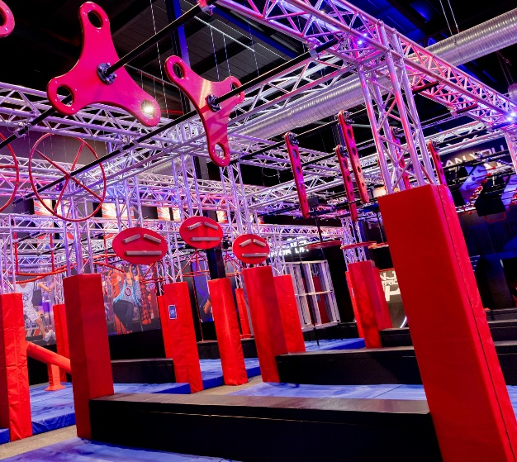
ALTON TOWERS
An early start to head down to the UK’s biggest theme park. Ride the big 8 thrill rides in one exciting day of adrenalin action
Number of Places: 45+
Additional requirements: Packed Lunch (or money for lunch),
£60.00
* Year 9 and 10 only. Depart 6:00am and return at 8:30pm. You must select this as a 1st choice to be considered for a place.
Mon
Tue
FLAMINGOLAND
Just a short trip down the road will set you up for a day of thrills and spills in heart of Yorkshire!
Number of Places: 45+
Additional requirements: Additional requirements: Packed Lunch (or money for lunch),
£45.00
* Year 7 and 8 only. Depart 8:00am and return at 5.30pm. You must select this as a 1st choice to be considered for a place.
Mon
Tue
NINJA WARRIOR AND CINEMA
Have you got what it takes to beat Ninja Warrior UK in Teesside. Put your skills to the test then chill out with a movie on an action packed day out.
Number of Places: 45
Additional requirements: Packed Lunch
£40.00
Mon
Tue

Slide 6


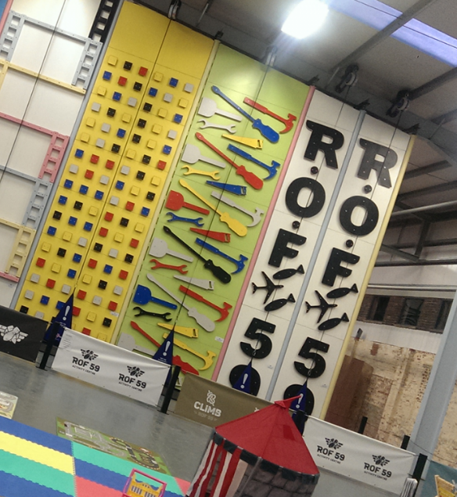
BEAMISH
Travel back in time and enjoy the UK’s top historical museum, perhaps buy the great ice cream and top fish and chips.
Number of Places: 45+
Additional requirements: Packed Lunch (or money for lunch),
£25.00
Mon
Tue
METROCENTRE
If shopping is your thing, then enjoy a day of retail therapy at the Metrocentre.
Number of Places: 45+
Additional requirements: Additional requirements: Packed Lunch (or money for lunch),
£10.00
Mon
Tue
ROF ACTIVITY CENTER
From a trampoline park to ‘clip and climb’, Lazer tag to and army assault course RoF 59 will have you more than covered.
Number of Places: 45+
Additional requirements: Packed Lunch
£30.00
Mon
Tue

Slide 7

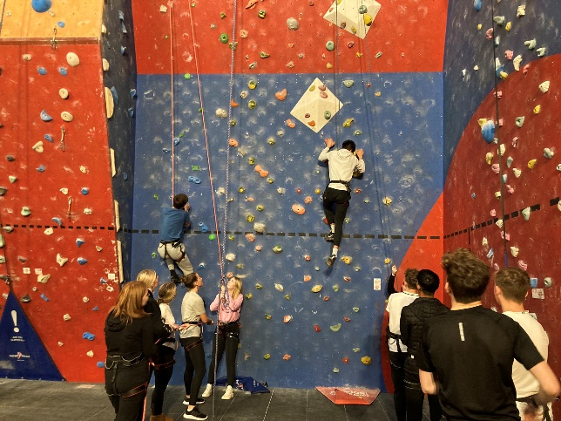
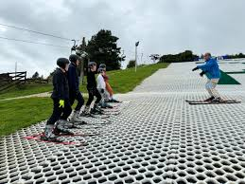
WATER SPORTS
Enjoy a morning on the beach, followed by an afternoon of Stand up Paddle boarding and Kayaking with CBK Adventures at Cullercoats.
Number of Places: 24
Additional requirements: Packed Lunch (or money for lunch), Towel and Swimsuit. Wetsuits are provided.
£40.00
Mon
Tue
* Return to school approximately 4.40pm
INDOOR CLIMBING
Enjoy a day of coaching at Sunderland climbing wall. Working in small groups you will be taught all the basic knowledge that you need to navigate your way around the walls!
Number of Places: 24
Additional requirements: Packed Lunch and comfortable clothing.
£25.00
Mon
Tue
DRY SLOPE SKIING
Hit the piste in the morning carving up the slopes with parallel turns and then in the afternoon enjoy some innertube sledging.
Number of Places: 45
Additional requirements: Packed Lunch, sun protection and water. Dress Code: school PE top and long trousers.
£30.00
Mon
Tue

Slide 8
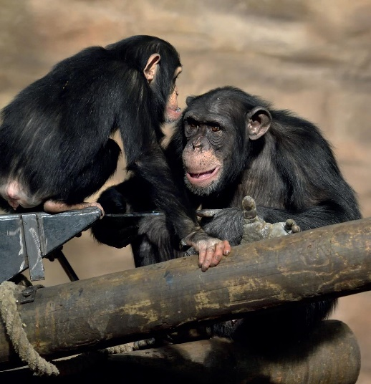
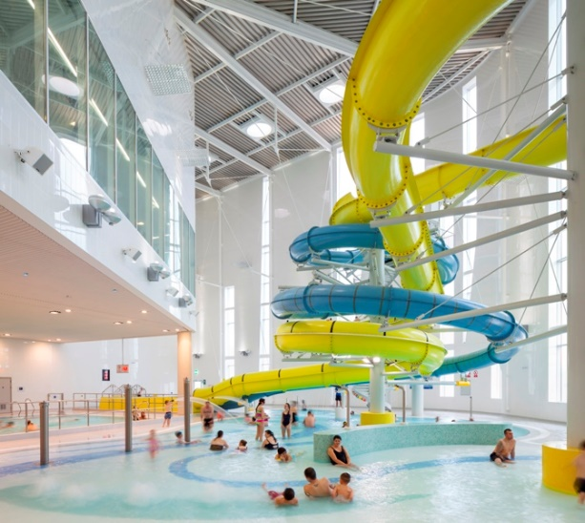

EDINBURGH ZOO
Enjoy an unforgettable day at the Zoo, exploring over 1000 rare and endangered animals and watching the famous Penguin Parade!
Number of Places: 45
Additional requirements: Packed Lunch (or money for lunch), sun protection and plenty of water for the day.
£45.00
Mon
Tue
* Depart 7:30am and return at 6:00pm
SWIMMING, QUASAR AND ARCADES
Travel to the local coastline at South Shields to play Quasar, Arcades and have a session at one of the biggest and best swimming facilities in the north east.
Number of Places: 45
Additional requirements: Packed Lunch and Swimming Kit
£20.00
£20.00
Mon
Tue
OUSEBURN AND THE VICTORIA TUNNELS
Immerse yourself in a piece of history, as you discover the mysteries hidden in the Victoria Tunnels beneath Newcastle. Enjoy an afternoon visiting the local sites at Ouseburn and the Quayside.
Number of Places: 30
Additional requirements: Packed Lunch or money for lunch
£25.00
Mon
Tue

Slide 9
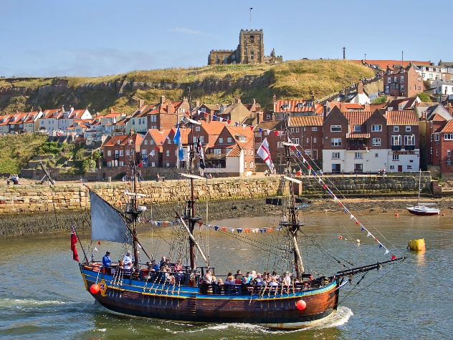
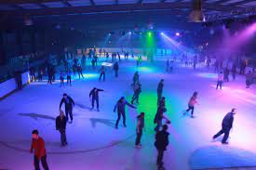

WHITBY
Enjoy an unforgettable day at Whitby, exploring the abbey, shops and arcades. The brave can even check out the Dracula experience as an optional extra!
Number of Places: 45
Additional requirements: Packed Lunch (or money for lunch), sun protection, spending money for arcades/shops and plenty of water for the day.
£20.00
Mon
Tue
* Return to school approximately 4:00pm
ICE SKATING
Showcase your skills on ice with an ice-skating session at Whitley Bay, followed by a stroll down the beach for lunch on the sands.
Number of Places: 24
Additional requirements: Packed Lunch (or money for fish and chips). Leggings or comfortable trousers recommended.
£25.00
Mon
Tue
YORK –TOUR AND RAILWAY MUSEUM
Enjoy a morning of exploration at York National Rail museum, followed by a tour of historical York, including the famous sites of Harry Potter!
Number of Places: 45
Additional requirements: Packed Lunch (or money for lunch), sun protection and plenty of water for the day.
£20.00
Mon
Tue
* Return to school approximately 4:15pm

Slide 10


BOWLING AND SWIMMING
A day spent having fun at the blowing alley and then at the swimming pool. Enjoy a chilled-out day with your mates getting strikes and making a splash
Number of Places: 24+
£15.00
Mon
Tue
Activities
2025
IN SCHOOL ACTIVITIES
ART, CRAFTS AND DESIGN
Get crafty and creative with a full day art session, where you can relax and practice your favourite techniques to produce a fantastic work of art!
Number of Places: 30
Additional requirements: None
FREE
Mon
Tue

Slide 11


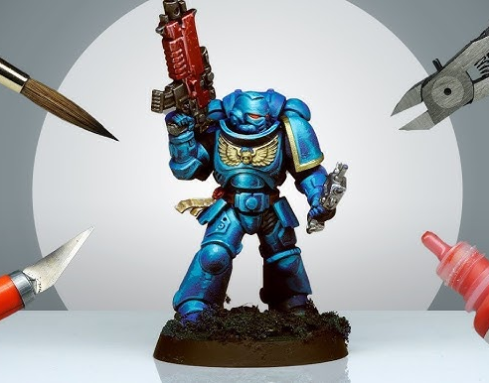
STEM FUN
Get creative and have fun completing a number of mini challenges and activities! Test you STEM skills and understanding over a full day's fun.
Number of Places: 30
Additional requirements: None
FREE
Mon
Tue
SHOW STOPPER BAKING
Make, bake and decorate your own summer celebration cake to celebrate the sunny happy days of summer!.
Number of Places: 24
Additional requirements: Ingredients to brought in from home.
FREE
Mon
Tue
WARHAMMER
Enjoy a day full of painting model characters and playing Warhammer.
Number of Places: 20
Additional requirements: None – Feel free to bring in personal Warhammer figures to play.
FREE
Mon
Tue

Slide 12


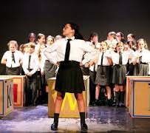
SPORTS – FOOTBALL
Showcase your skills and battle it out on the Astroturf for a day of friendly, competitive football.
Number of Places: 30+
Additional requirements: PE kit, sun protection, water bottle and suitable footwear.
FREE
Mon
Tue
SPORTS - MULTISPORT
Have fun with friends, taking part in a range of sports on offer, including Dodgeball, Basketball, Badminton and Table Tennis.
Number of Places: 30+
Additional requirements: PE kit, sun protection,water bottle and suitable footwear.
FREE
Mon
Tue
PERFORMING ARTS FOR THE DAY (FULL DAY)
Get musical and dramatic by working towards a performance in 1 day. Improve your keyboard, singing, drama and/or dance skills. Work as a soloist or in a group - you'll have the chance to create a mini performance in one day.
Number of Places: 30
Additional requirements: None
FREE
Mon
Tue
Mon
Tue

Slide 13
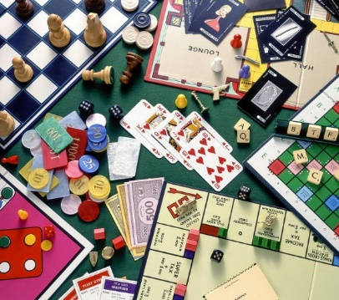


BOARD GAMES BONANZA
Enjoy a variety of board and card games for you to test your wits (and each other). Feel free to bring your own games too.
Number of Places: 16
Additional requirements: Welcome to bring in your own card/ board games to play.
FREE
Mon
Tue
MAKE UP TUTORIAL
Spend the day learning how to apply make up and create great looks, with a little help from your friends too!
Number of Places: 25
Additional requirements: Feel free to bring in your own make up to use throughout the session.
FREE
Mon
Tue
MOVIE MARATHON
Tired after a year of working hard at school? Then, sit back, relax and enjoy a movie with friends and snacks!
Number of Places: 30
Additional requirements: Feel free to bring your own popcorn and snacks.
FREE
Mon
Tue

Slide 14


FIFA AND MINECRAFT
A day of games and action on the computer. Building amazing objects out of blocks and sweating on goals. A must choice for all you gamers out there.
Number of Places: 24
Additional requirements: Welcome to bring in your own card/ board games to play.
FREE
Mon
Tue
LEGO CRAZY
Spend the day building you best Lego ideas and a inventions in school.
Number of Places: 25
FREE
Mon
Tue

Slide 15

What Happens Next?.....
Friday 9th May - Information booklets handed to students in assembly/tutor time and activity week is launched
Friday 9th May until Wednesday 14th May - Students complete online Teams Form, selecting their choices with their parents./carers
Friday 23rd May - Student choices confirmed to pupils and parents/carers and payment window opens
Monday 16th June - Deadline for all Parentpay payments and deadline for consent forms to be handed in.
Free school meal students only - Complete packed lunch request form if a packed lunch is required for any off-site trips. The form will be provided by Head of Year and should be returned to the Head of Year by Monday 14th July
Monday 21st and Tuesday 22nd - Activities Day.

