Slide 1




Slide 2
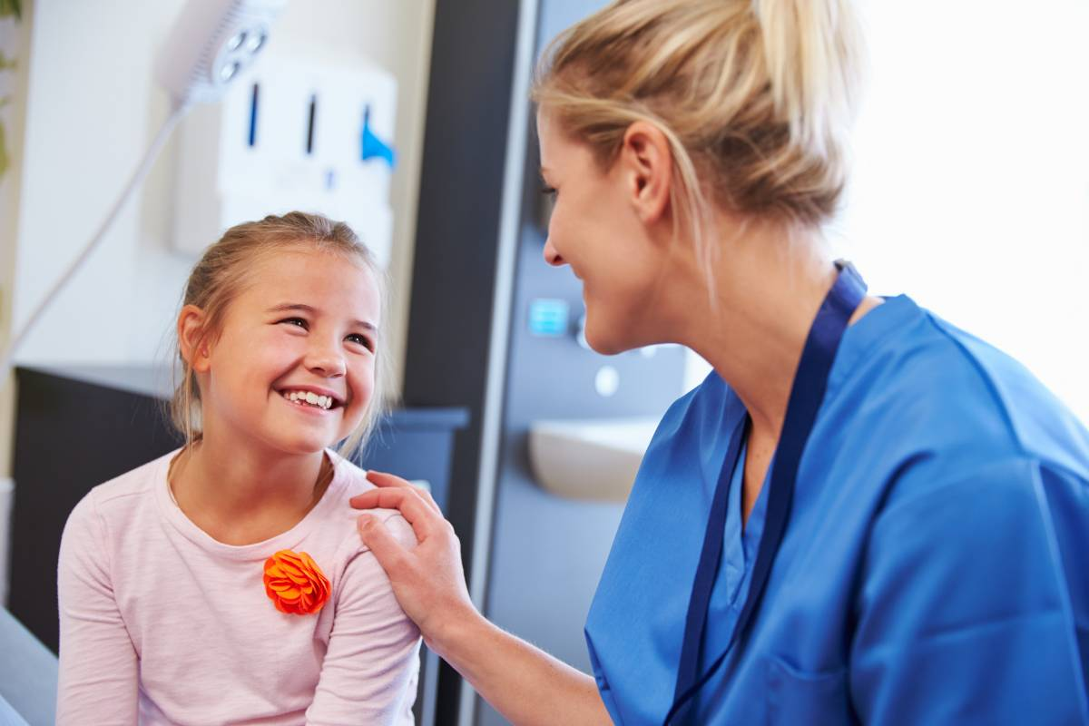
Who are we?
We are a team of nurses and administration assistants that provide Immunisations to children and young people in line with the national program.
The Immunisations we provide in schools are:
  Flu
  HPV (Human papillomavirus)
  Tetanus, Diphtheria, Polio (3 in 1)
  Meningitis ACWY
  Mumps, Measles and Rubella (MMR)

Slide 3

Year 8 vaccines
In year 8 you will be offered the HPV vaccine:
The HPV vaccine has been offered to boys and girls in year 8 since 2019
The HPV vaccine is called Gardasil 9
The HPV vaccine helps protect you from being infected by the human papillomavirus (HPV)

Slide 4

ALL ABOUT HPV

Slide 5

Potential Side effects:
As with most vaccinations, the side effects of the HPV vaccination are quite mild.
Soreness, swelling and redness in the arm are common but wear off in a couple of days.
Headaches and aching muscles or joints
Feeling tired or having a mild fever
Feeling sick
More serious side effects are extremely rare.

Slide 6
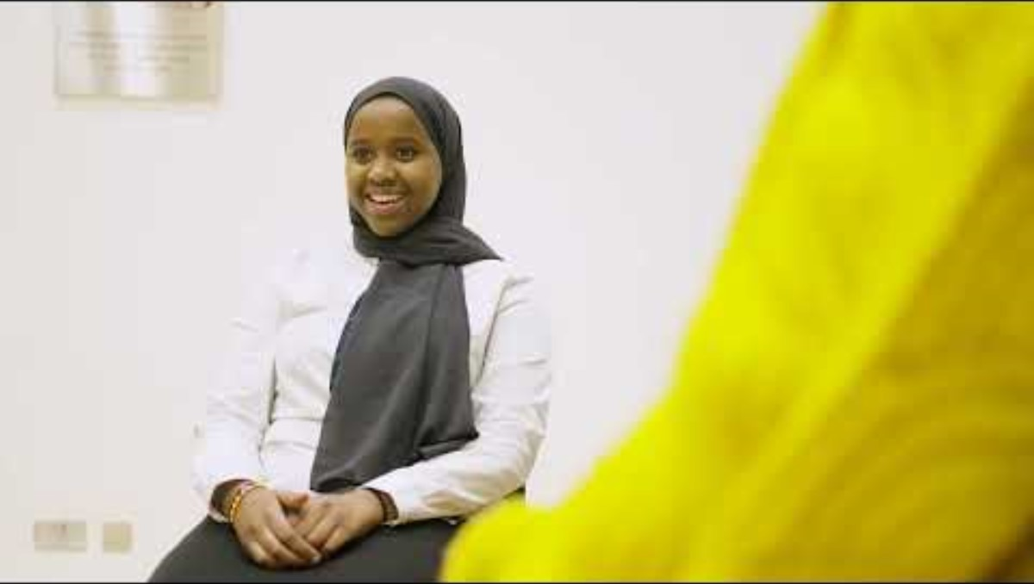
WHAT TO EXPECT ON THE VACCINATION DAY

Slide 7

Prior to the session we will send a link home for parents to consent to the vaccines.
On the day of the session if your parent has not given consent we will attempt to contact them if you wish to consent to the vaccine
If we are unable to contact a parent/guardian we can assess you to see if you can self consent. This is known as being ‘Gillick Competent’

Slide 8

Gillick competence (Self consent)
Children under the age of 16 can consent to their own treatment if they're believed to have enough intelligence, competence and understanding to fully appreciate what's involved in their treatment. This applies to many aspects of healthcare including sexual and mental health services. Being competent to self consent is known as being ‘Gillick competent’ .
To be considered Gillick competent you must demonstrate:
You understand the immunisation being given
You understand what the immunisation is protecting you from
You understand the risks of not having the immunisation
You understand the potential side effects of the vaccines
You must also show you can retain the information and make an informed decision.
A nurse will discuss this with you on the day of vaccination if you wish to self-consent.

Slide 9

EMAIL:
immunisations.s-st@intrahealth.co.uk
C O N T A C T N O .
03333 583 397 option 3 option 1

